Slide 1
Private Woodlots Outaouais
2014

Slide 2
Private / Public Forests (Québec)

Slide 3
Private / Public (Outaouais)

Slide 4
Area Private Woodlots Outaouais | 7720 km carrés
Area Private Woodlots Outaouais | 772 000 ha
Private Woodlot Owners (Outaouais) (4 ha) | 10 900
Average Area per Ownership | 113 ha /282 acres
Average Area per Ownership ***** | 47 ha ou 117 acres
**** Les grands propriétaires (800 ha) sont exclus de l’analyse

Slide 5
Productive Ownership

Slide 6
Private / Public AAC

Slide 7
Private Wood Procurement in 2013

Slide 9
130 000 woodlot owners in Québec

Slide 10
Woodlot Owner Status
Conditions
Ownership of > 4 hectares of forested land
Draft a woodlot management plan PAF
Land owner commitment
Advantages
Cost shared silviculture investment program
Income tax credit program (based on land tax payment)
Forest loans program currently at 3%
Capital gains advantage with family succession

Slide 11
36 000 statuated owners in Québec

Slide 12
Group Ventures OGC or individual assistance

Slide 13
1062 status owners /Outaouais

Slide 14
Proportion who benefitted from programs in last 5 years

Slide 15
Since 1996 | 33 millions $
Number of eligible woodlot owners (>4 ha) | 10 900
Average annual beneficiaries | 419
Woodlot management plans | 3 307
Active plans | 1 062

Slide 16
Since 1996 | 33 millions $
 | Hectares | en 000$
Plans d’aménagement forestier | 3307 | 1 352
Préparation de terrain | 4386 | 3 201
Plantations 22 millions d’arbres mis en terre | 10 000 | 6 520
Entretien de plantations | 8 336 | 5 899
Éducation de peuplement / non commercial | 7 692 | 6 455
Éclaircies commerciales $$$ | 13 297 | 9 025
Voirie forestière 336 kilomètres |  | 0,459

Slide 17
Since 1996 / 47 000 hectares treated

Slide 18
Since 1996 / 33 millions dollars invested

Slide 19
Property Tax Evaluation 2000-2010

Slide 20
Taxes foncières – Évolution 2000-2010

Slide 21
Woodlot taxation vs revenue Pontiac

Slide 22
Woodlot Owner Tax Base Pontiac
Ownership > 4 hectares of forested land = 194 225 hectares
Average area per evaluation unit = 54,10 hectares
Evaluation per forested hectare = 776,57
Evaluation per forested acre = 310 $
Average Evaluation per tax Unit = 42,000 $
Land tax burden per forested hectare = 7,77 $
School tax burden per forested hectare = 1,79 $
Total tax burden per forested hectare = 9,56 $

Slide 23
Woodlot taxation Outaouais

Slide 25
Socio – demographic Profile

Slide 26
Socio – démographic Profile

Slide 27
Socio – démographic profile
 | Total | %
 | N=1062
Propriétaires de boisés statués en Outaouais en 2011
Homme propriétaire unique | 472 | 44%
Femme propriétaire unique | 98 | 9%
Couples | 246 | 23%
Copropriété, 2 personnes et plus , autres | 115 | 11%
Organismes, municipalités , clubs ou fermes | 66 | 6%
Compagnies à numéro | 65 | 6%
 | 1062

Slide 28
Gender | Total | %
 | AFPO 2011 N=1062
Propriétaires de boisés en Outaouais (données AFPO 2011)
Homme | 718 | 67%
Femme | 344 | 33%

Slide 29
 | N=194 FPFQ 2012 | %
 | Âge des propriétaires (Outaouais)
 | Moins de 25 ans | 0%
 | 25 à 34 ans | 1%
 | 35 à 44 ans | 7%
 | 45 à 54 ans | 23%
 | 55 à 64 ans | 29%
 | Plus de 64 ans | 38%
 | Average Age …….62 ans…..highest in the province

Slide 30
Age / Outaouais

Slide 31
Schooling completed (Outaouais)

Slide 32
Duration Ownership

Slide 33
73% own the land for longer than 10 years, 51% own the land for longer than 20 years. For the ones who harvested wood in the last 5 years, we account for a majority of long term landowners (ownership > 20 years).

Slide 34
Work Occupation

Slide 35
Family Income

Slide 36
Proportion of revenue from woodlot

Slide 37
Profil socio-démographique
Where do you live ?
On the farm | 12%
On the woodlot or closeby | 55%
In the city | 25%
More than 30 km | 22%
Out of Québec | 15%

Slide 38
Profil socio-démographique Distance résidence principale et boisé

Slide 40
Why keep a woodlot

Slide 41
Proportion active

Slide 42
Motivation for ownership

Slide 43
Intentions next 5 years

Slide 44
Proportion active

Slide 45
Why are you inactive ?

Slide 46
Proportion who harvested in last 5 years

Slide 47
Data of ownership
Many owners have 1 woodlot. Most owners own two woodlots. 10% own 3 woodlots
On average small owners who manage their woodlots own 93 hectares (232 acres).
On average, multiple ownership, and companies own 290 hectares (725 acres).

Slide 48
Data of Ownership
Dans l’unité de gestion 723, cinq (5) grands propriétaires possèdent à eux seuls plus de 60 000 hectares et les terres qu’ils aménagent couvrent plus du tiers des surfaces sous aménagement en Outaouais.
Nous avons soustrait les superficies détenues par les cinq plus grands propriétaires afin d’établir des caractéristiques et moyennes pour l’ensemble des producteurs. 222

Slide 49
Sustainable Revenue/ Sustainable Management ??? Forestry
AREA | AAC | REVENUE | EXPENSES
54,1 ha lot | = 135 m3 = 4 loads/yr | 1080 $ | Tax + 3% interest + Maintenance | 520 $ 1260 $ 1000 $ -------- 2780 $
10 x 54 ha lots = 540 ha | 1350 m3/yr = 40 loads | 10,800 $ | Tax + 3% interest + Maintenance | 5,200 $ 12,600 $ 10,000 $ -------- 27,800 $

Slide 50
Sustainable Revenue/ Sustainable Management ??? Agriculture
AREA | REVENUE | EXPENSES
54,1 ha lot | @ 75$ 4,057 $ | Tax + 3% interest + Maintenance | 225 $ 1260 $ -------- 1,485 $
10 x 54 ha lots = 540 ha | 40,057 $ | Tax + 3% interest + Maintenance | 2,250 $ 12,600 $ -------- 14,850 $

Slide 51
Challenges 2014-2017
Review Regional woodlot Management Plan PPMV
Fair subsidy system based on productive forest area
Rethink afforestation /tree planting
Increase commercial activities / Improve landowner revenue
Harvest a larger portion of AAC
Priority to recuperation after acts of God / windthrow / storms / infestations
Improve municipal regulations / Tree cutting by-laws and landscape protection
Forest certification and forest worker accreditation
Training the workforce

Slide 52
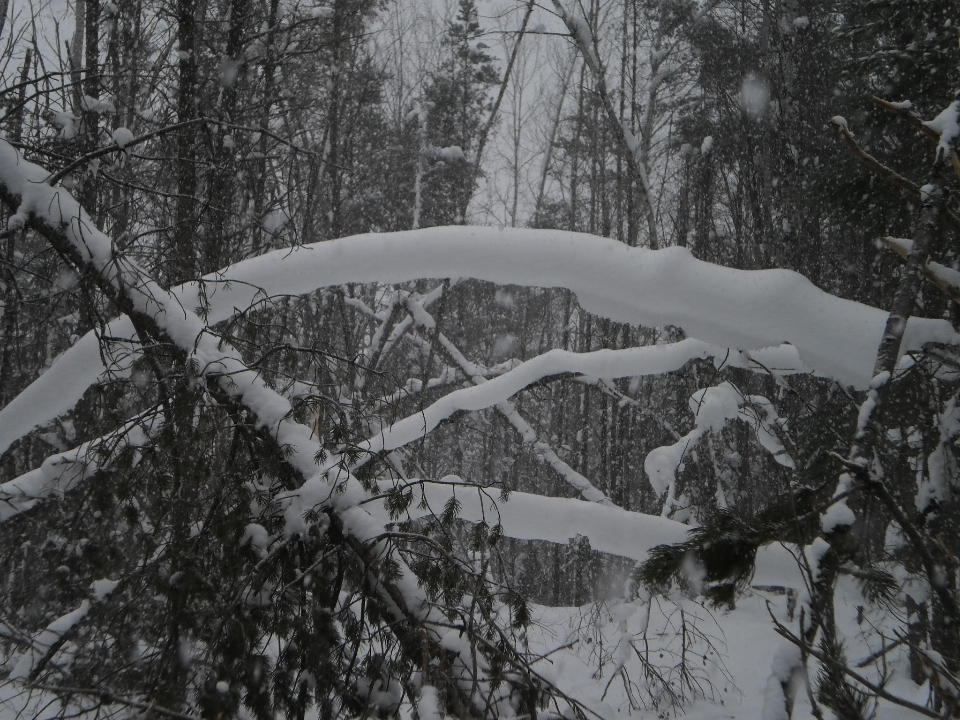

Slide 53
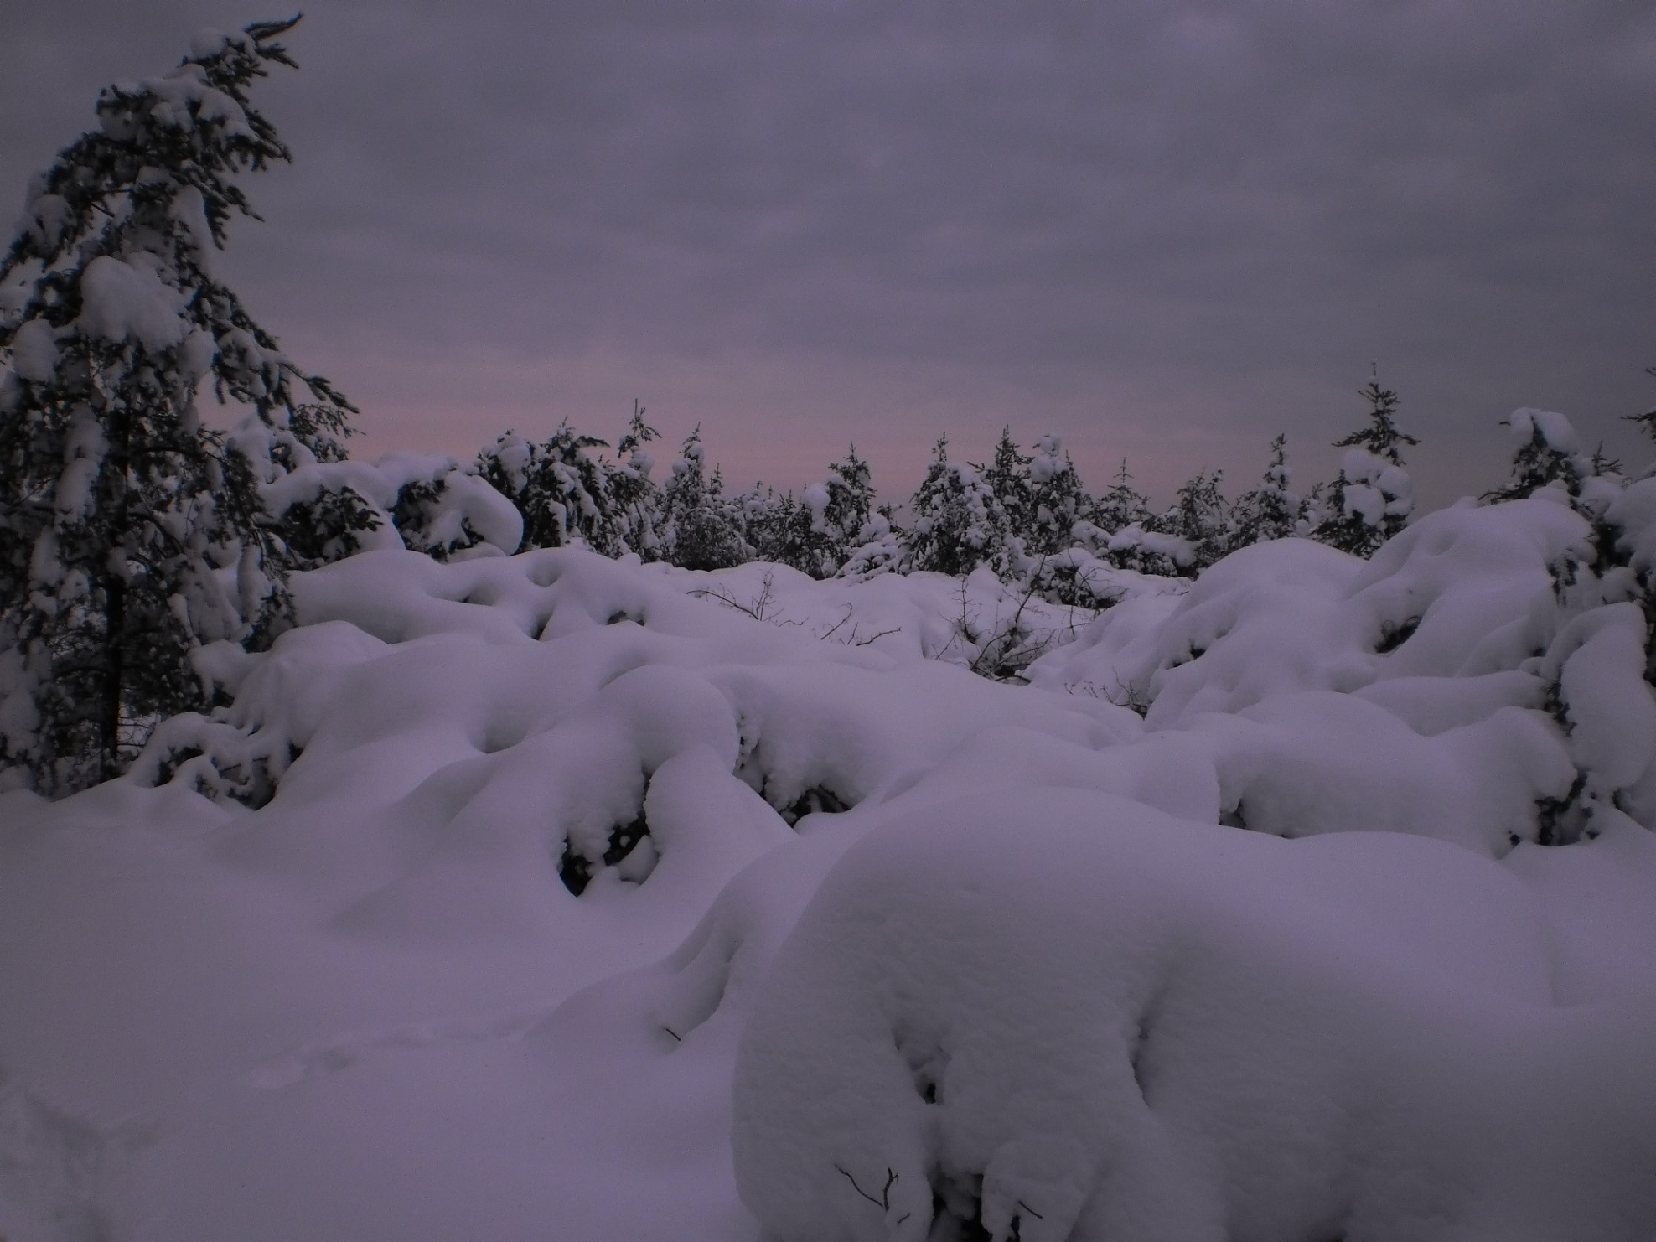

Slide 54
